Slide 1
Helping your Teen Live a Healthy, Successful, and Fulfilled Life April 13, 2023- MRHS

Slide 2
What Do We Want for Our Students?
Happy, Healthy, & Engaged
Post Secondary Options

Slide 3
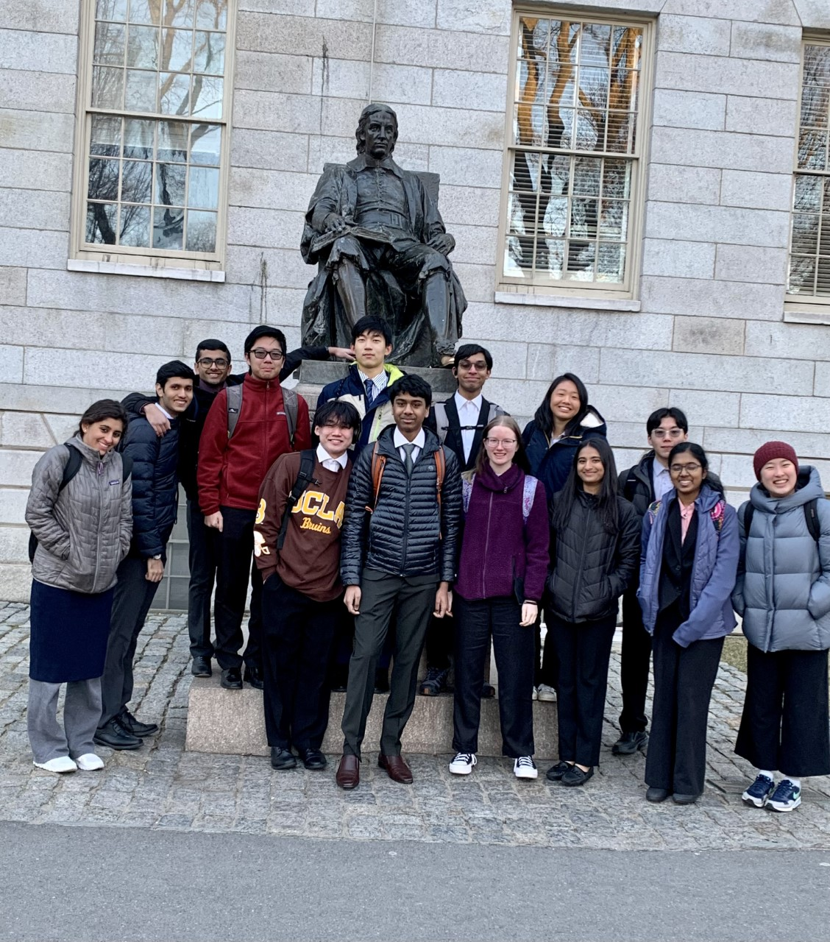
Developing a Well-rounded and Competitive Resume
Ms. Raquel Sobczac
Admissions Representative
University of Maryland

Slide 4
Helping your Teen Live a Healthy, Successful, and Fulfilled Life
Mark Donovan, LCPC, LCADC, CCO
Shannon Garrett, LMSW, LCADC
Congruent Counseling Services and Integrative Counseling

Slide 5
Marriott’s Ridge High School
Adolescents think differently
Values and Morals, good job parents!
Teen Stages of Development, gaining autonomy
Identifying Life Stressors
Adolescents
College bound teens
Warning signs that your child needs help
Depression, Anxiety and SUD symptoms
Things you can do to protect and prepare your child
Where to find help
Q and A

Slide 6
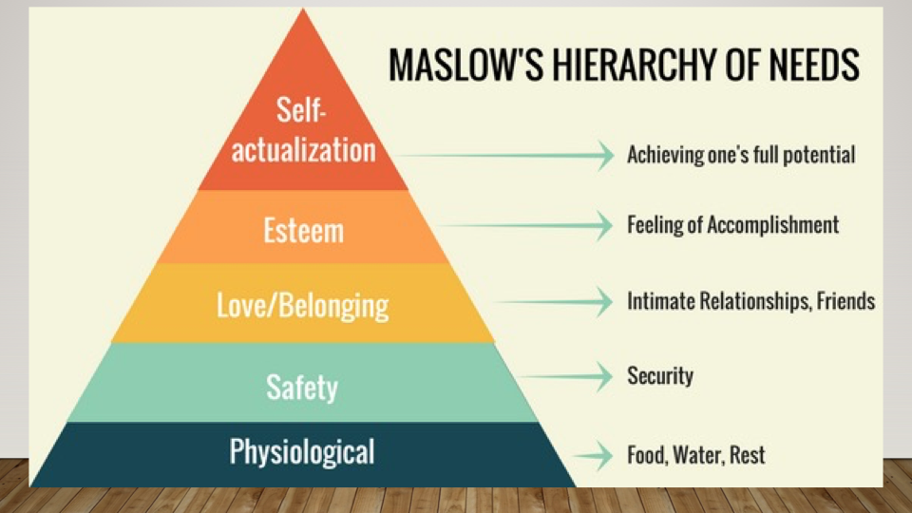
Adolescent Thinking

Slide 8
The Trapeze Artist
Erik Erikson presented the Adolescent as a trapeze artist.
How the young person in the middle of vigorous motion must let go of their safe hold on childhood and reach out for a firm grasp on adulthood.
As parents we do not always manage this gracefully.
Adolescents either seem too quick to let go or struggle to let go.
Parenting strategies.

Slide 9
Values That You Have Taught and Modeled
Honesty
Responsibility
Compassion, be kind
Respect
A strong work ethic
Determination, vigilance
Put forth effort
Have a sense of humor
Be yourself
Be proud of who you are
Good study habits
Social skills
Manners
Take care of your world
Make good choices
Think about your decisions
Be a trustworthy friend
Ask for help, give help
Respect your culture
Resiliency, bounce back and try again.

Slide 10
Adolescent Life Stressors
Where do I fit in?
Friendships
Falling in love
Family life
Academic pressure to succeed
What am I going to be?
What am I good at? Or not?
Safety
Peer pressure
Bullying
Parental expectation
Social media (FOMO)
Driving
Substance Use
Mental Health
Loss
Transitions
Getting into college
Working
Money
Etc….

Slide 11
Is Your Teen Struggling?
Isolating more than usual, avoiding family and friends
Sleep disturbance
Easily frustrated and irritable
Periods of sadness, crying
Lack of interest in normal activities
Appetite changes
Changes in friendships
Anger outbursts
Fearful, nervous, anxious
Substance use initiation
Chronic physical complaints
Depression?
Anxiety?
Bipolar?
ADHD?
SUD?

Slide 12
Reach Out for Help Now
Thoughts of suicide
Talking about wanting to die
Self injurious behavior
Reports of abuse, rape
Regular substance abuse
Experienced traumatic event
They ask for help
911 for emergency
988 is the crisis hotline

Slide 13
Things You Can do to Help
Be available
Listen without Lecturing
Lead by Example
Check in with them
Encourage them to talk
Ask open ended questions
Catch them doing the right things
Ask questions about friends
Talk about decision making
Help them weigh out pros and cons
Help them prepare for life transitions

Slide 14
More Things You Can Do To Help
Build in some fun time with your teen, but don’t make them.
Offer to help, but be careful not to give it unsolicited
Talk about your day with them
Model awkwardly talking about feelings
Support their interests, ask questions
Talk about how you handle making mistakes
Let them know you love them
Be a safe place

Slide 15
Supporting the College Bound Teen
Park the Helicopter: let them work it out unless they ask for help.
Encourage Resourcefulness: colleges have resources. Tutoring services, health services, counseling services, social networks.
Encourage Resilience: be supportive when things go wrong, not as planned or harder than they thought.
Support Career Discovery: encourage discussion around career fit and encourage career coaches or counselors at school and universities.
Recognize Risk: If you suspect a problem, take action and ask for help.
Be there for your young adult without being intrusive.
Anticipate change in their mood.
You are an important source of support, take care of you.
Be aware of your own emotions and seek support as needed.
Rediscover your talents and interests.

Slide 16
Thank You for Attending Tonight
Can we answer any questions for you?
Thank you for allowing us to be of service.

Slide 17
Congruent Counseling Services and Integrative Counseling
Check out or website: www.congruentcounseling.com
Call us if you think you need help 410-740-8066
Mental Health Therapy
Substance Use Disorder Treatment
Intensive DBT Treatment

