Slide 1
Youth Wellness & Mental Health
Denise Giuliano
Executive Director
NAMI Howard County dgiuliano.namihc@gmail.com
Joseline Castaños
Parent Support Group Facilitator, NAMI Volunteer
joselinecastanos@gmail.com
Notes:
NAMIHC is a local affiliate of the National Alliance on Mental Illness.
Created 40 years ago for families of a loved one with severe mental illness.
In the last 5 years or so, the organization has opened its umbrella to include behavioral health issues such as mood disorders, stress and self-regulation.
The idea being to reach those on the early-side of experiencing symptoms.
Just like physical diseases and disorders, early intervention leads to significantly better outcomes in a person’s life.

Slide 2
Why does Mental Health Matter?
Mental health can affect your child’s
Ability to learn
Attendance
Relationships:
peers, family, school, community
Physical health
Long-term success
This Photo by Unknown Author is licensed under CC BY-NC
Notes:
Pandemic has intensified our emotions on all levels -- I heard a doctor describe it as:
The Perfect Storm – The great “unknown”, Social Isolation, Lack of sense of time and purpose, Inability to engage in usually pleasant activities, Negative/irrational thoughts are coming true
Our kids are absolutely feeling the effects, even if they do not articulate it in the same way we do.
Mental health matters because there can be no physical health without mental health.

Slide 3
Facts about Mental Health & Youth
13% (ages 8-15) and 20% (ages13-18) of youth live with a mental health condition¹
50% of mental health conditions have signs and symptoms by age 14
50% of 8-15-year olds with a mental health condition don’t receive treatment¹
The average delay between onset of symptoms and treatment is 8-10 years¹
17% of high school students seriously consider suicide²
This Photo by Unknown Author is licensed under CC BY-NC-ND
¹NAMI. (2013). Mental Illness Facts and Numbers. ²Center for Disease Control and Prevention. (2014). Youth Risk Behavior Surveillance–United States, 2013. Morbidity and Mortality Weekly Report, 63(4), 1-168.
Notes:
Half of all mental health conditions have signs and symptoms by age 14.
Important to note: Behavioral challenges seen in teens CAN BE an indicator of an emerging mental illness.
Left untreated these disorders can become:
more severe
more difficult to treat and
lead to a poorer lifetime prognosis
Best thing we can do to protect our children’s mental health is to be educated and aware.
Mental health conditions also have a significant genetic component so knowing your family’s history can be helpful.
IMPORTANT: Mental health conditions are no one’s fault. Caused by biological and environmental factors. Can sometimes emerge as the result of trauma (Pandemic can certainly be classified as a traumatic event).

Slide 4
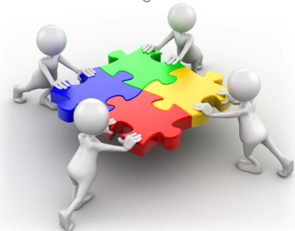
Why Partner with Schools?
You and their teachers are the closest observers of your child.
Behaviors caused by mental health issues can look very different at home and school.
Good communication between school and families helps get a complete picture of the issue.
Early identification & intervention offers the best chance for student success.
This Photo by Unknown Author is licensed under CC BY-SA-NC
Notes:
Can’t be overstated how important it is to communicate with your child’s teachers and/or guidance counselor if you see concerning behaviors with your teen.
Can be trickier as they get older since they may communicate with us less (we may not always know when they are struggling) and they are more self-conscious about appearing different from their peers.
Encourage them to self-advocate but let them know you have their back if they need back-up.

Slide 5
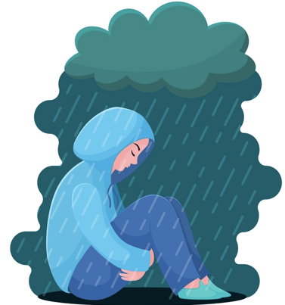
Know the WARNING SIGNS
Youth with mental health conditions can experience constant, unrelieved and challenging symptoms.
Keys to Early Symptom Recognition:
Intensity: how severe are the symptoms?
Duration: how long do they last?
Level of distress: how much do they impair daily functioning?
This Photo by Unknown Author is licensed under CC BY-SA-NC
Notes:
Parents often ask what is the difference between normal “teenage attitude” and early warning signs of mental health conditions?
Keys are Intensity, Duration and Level of Distress
Can be difficult to know for sure but trust your gut – if you think something may be wrong, there is never any harm in talking to your child’s doctor.

Slide 6
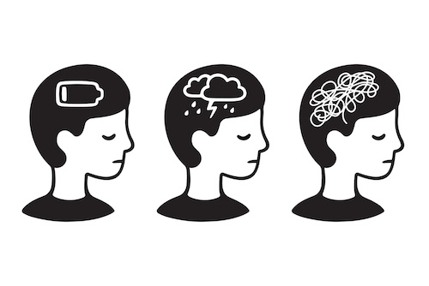
Warning Signs of a Mental Health Condition
Feeling very sad or withdrawn for more than two weeks
Severe out-of-control behaviors
Sudden overwhelming fear for no reason
Severe mood swings that cause problems in relationships
Drastic changes in behavior, personality or sleeping habits
https://www.fotosearch.com/CSP660/k63726873/
Notes:
General warning signs of a mental health condition
The warning signs are the same for adults, by the way.

Slide 7
Warning Signs of a Mental Health Condition – Cont’d
Extreme difficulty concentrating or staying still
Not eating, throwing up or using laxatives to lose weight
Repeated use of alcohol or drugs
Trying to harm or kill oneself or making plans to do so
This Photo by Unknown Author is licensed under CC BY-NC
Jensen et al. (2011). Overlooked and Underserved: “Action Signs” for Identifying Children With Unmet Mental Health Needs. Pediatrics, 128(5), 970-979.

Slide 8
Behaviors Often Seen at Home
Nothing seems to please them
“Over the top” reaction to an ordinary event or task
Demanding behavior
Severe changes in sleeping and eating habits
Prefers isolation to involvement in social activities
This Photo by Unknown Author is licensed under CC BY-SA
Notes:
Yes, we are talking about teenagers (who can be volatile in the best of times but are now) experiencing all of the stress of recent events. It can be difficult to know -- but TRUST YOUR GUT.
Last one is more challenging in a pandemic environment. It’s easy for kids to withdraw from social activities when there are considerably less of them and they take on different forms. Kids can “get in a rut” just like we do. (ex. daughter’s friends)
Even older kids need help thinking of activities they can do with others
Offer suggestions for activities, participate when you can.
Try to facilitate safe activities with friends.

Slide 9
Behaviors Often Seen at School
Misses class frequently
Misses assignments and tests
Quality of work gets worse
Extremely disorganized
Expresses violence, thoughts of death, hopelessness, social isolation or confusion in schoolwork
Frequently seeks special conditions
Shows patterns of perfectionism
Responds very emotionally to grades
Licensed under CC BY-SA
Notes:
Clearly teachers have greater difficulty observing these behaviors during virtual school. We all feel less connected.
With so many kids having cameras off during class, teachers are unable to “see” students who may in distress or just need extra support.

Slide 10
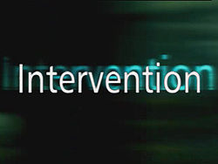
Risks of Not Intervening
If we don’t intervene in children’s mental health, statistics show us that:
This Photo by Unknown Author is licensed under CC BY-SA
50% of students ages 14+ with an untreated mental illness drop out of high school
70% of youth in juvenile justice systems have a mental health condition
More than 90% of youth who die by suicide had one or more mental health conditions
Suicide is 2nd leading cause of death for 15-24-year-olds
NAMI. (2013). Mental Illness Facts and Numbers.
Suicide is the leading cause of death for youth ages 15-19 in Howard County (2014-2016).
Notes:
These stats can be upsetting
If you ever hear your child express suicidal ideation TAKE IT SERIOUSLY. ALWAYS.
If the illness had been treated, the deaths could likely have been preventable.
If they are in crisis, call the Howard County Mobile Crisis Team (MCT) at: 410-531-6677. If it’s after 11pm, call 911 and let them know your child is having a mental health crisis.
HCPD is trained in Crisis Intervention.

Slide 11
Become an ADVOCATE for Your Child
Talk with their doctor
Keep a record of concerns
Get a referral to a mental health specialist
Maintain regular communication
Help teachers understand your child’s challenges
Connect with other families
NAMI Parent Support Group, Basics OnDemand
This Photo by Unknown Author is licensed under CC BY-SA

Slide 12
NAMI Howard County as a Resource
FOR PARENTS/CAREGIVERS:
Support Groups
Classes
Connection to Local Resources
Community Awareness Programs
All at NO cost
www.namihowardcounty.org or 410-772-9300
Notes:
Two monthly support groups for parents/caregivers --
School-aged kids
Transition Age Youth (TAY) – age 16-26. (Joseline will give more information.)
Basics onDemand – 6 week course at nami.org that helps parents understand behavioral challenges and how they CAN be symptoms of an emerging mental illness.
Goes over treatment options, and
How to manage behaviors and set healthy boundaries

Slide 13
NAMI In Schools
For Students: presentation given to middle and high school students by a young adult who experienced a mental health condition during his/her school years and a either a second young adult or a family member of an individual who experienced mental challenges in school.
For Parents and School Staff: Helps recognize warning signs of mental health conditions in youth and helps foster a collaborative approach to create a supportive learning environment.
Notes:
For students, program addresses suicide, signs and symptoms of behavioral health conditions and how to help a friend.
For parents and school staff, presentation is very similar to information we have shared tonight.
One of the best parts about all NAMI presentations -- given by trained volunteers who share their lived experience.
Previously given ETS in-person and are able to do them virtually. Excited to share that the Active Minds club at MRHS has scheduled a virtual ETS presentation for Friday, February 19th after school.
I hope you will encourage your teen to attend.

Slide 14
How You Can Help Your Teen
LISTEN.
Allow emotional responses; LABEL and VALIDATE them.
Be HONEST. It’s okay to admit we are struggling too.
Instill confidence during challenging times. They are persevering!
Teach and model good coping skills (breathing, stress breaks, healthy eating, regular exercise)
KEEP CHECKING IN.
Practice self-care
Notes:
Lastly, I want to share some tips on how to help your teen.
As parents we often want to FIX everything for our kids. I know I am guilty of this. Sometimes kids just want to vent -- allow them that space.
SELF CARE – We can’t help our families if we are holding on by a thread ourselves. Find a few minutes to breathe, read a book, take a walk. GET SUPPORT for yourself.
Most of all, as we are all trying to get through this pandemic, remember what is important: FLEXIBILITY, NOT PERFECTION.

Slide 15
This Photo by Unknown Author is licensed under CC BY-SA-NC
Notes:
Will give my background story, challenges with my daughter, point to the hope found in NAMI and why I’m here now.

Slide 16
What is a NAMI Parent Support Group?
Group of parents/caretakers
of children 18 and under facing challenges
no diagnosis required
Confidential
A place to find non-judgmental support
Facilitated by trained volunteers
Free Monthly Meetings
Online (since April 2020)
This Photo by Unknown Author is licensed under CC BY
Notes:
NAMI Family Support Groups, offered by NAMI Affiliates in communities across the country, are free, confidential and safe groups of families helping other families. At NAMI Howard County, we have a Parent Support Group for caregivers or parents of children 18 and under facing challenges. In this Support Group, families join a caring group of individuals helping one another by utilizing their collective lived experiences and learned wisdom. Family members can achieve a renewed sense of hope for their loved one and the strength to cope with the challenges. If your child is exhibiting any of these signs, join us for support!

Slide 17
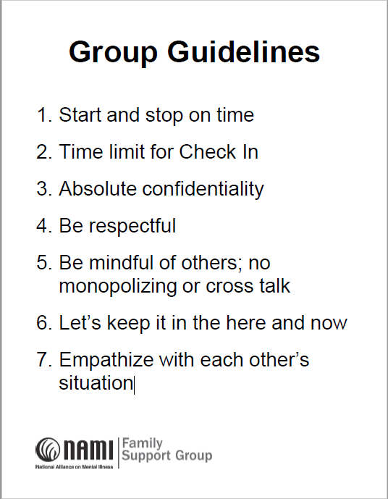
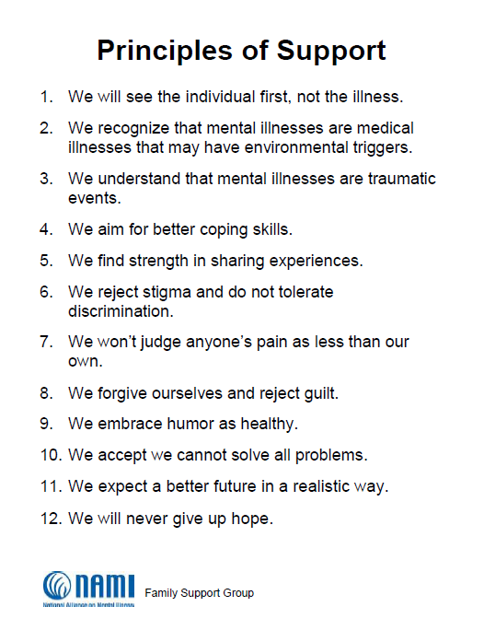
What happens in a parent support group?

Slide 18
How do you join a parent support group?
Parent Support Group for parents/caregivers of school-aged kids
Second Monday of the Month
7:30pm-9pm
You register through Eventbrite
You attend through Zoom (Instructions)
Online Support Group Frequently Asked Questions

Slide 19
Denise Giuliano Executive Director NAMI Howard County 410-772-9300 dgiuliano.namihc@gmail.com
Feedback
https://forms.gle/eSbmMQr99FogJhwm9
Notes:
https://forms.gle/eSbmMQr99FogJhwm9

